Slide 1
Taxation of Royalties and Fees for Technical Services including TDS under Section 195
DIRECT TAX HOME REFRESHER COURSE - 5
CA Pradip K Modi 22/05/2024

Slide 2
Taxation of Royalties and Fees for Technical Services including TDS under Section 195-I T ACT
Basics for selected topic :
  Section – 99 of Government of India Act, 1935
  Constitution of India – Article : 265, 51, 245
  Chapter II (Section 4 -9B)
  Chapter IX (Section 90-91)
  Chapter XII (section (110-115BBJ)
  Chapter XVII (Section 190-206B)
  Tax Treaties
  Multilateral Instrument (MLI)
  Income Tax Rule 21AB –Read with Sec 90(4) –form 10F
  Income Tax Rules 26 -Rate of currency for TDS credit
  Income Tax Rule 28-Application u/s 197 form 13
  Income Tax Rule 29B-Application u/s195(3)
  Income Tax Rule 37BB-Filing form 15 Ca and CB
  Income Tax Rule 37BC-Sec 206AA not apply on payment Int, Royalty,FTS
  Dividend and Capital Gain
CA Pradip K. Modi

Slide 3
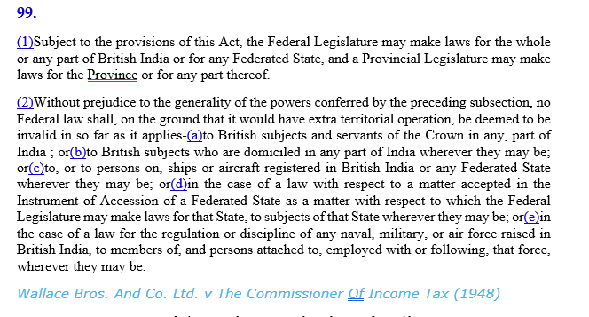
Taxation of Royalties and Fees for Technical Services including TDS under Section 195-I T ACT
Section – 99 of Government of India Act, 1935
CA Pradip K. Modi

Slide 4
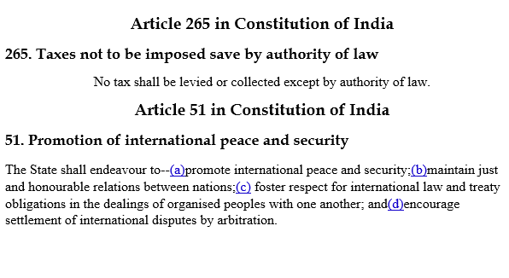
Taxation of Royalties and Fees for Technical Services including TDS under Section 195-I T ACT
Constitution of India Article – 265 ,51,245
CA Pradip K. Modi

Slide 5
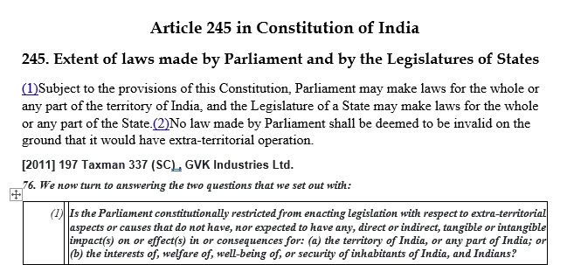
Taxation of Royalties and Fees for Technical Services including TDS under Section 195-I T ACT
Constitution of India Article – 245
CA Pradip K. Modi

Slide 6
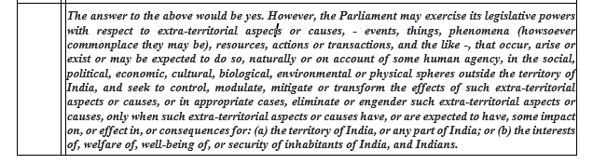
Taxation of Royalties and Fees for Technical Services including TDS under Section 195-I T ACT
Constitution of India Article – 245
CA Pradip K. Modi

Slide 7
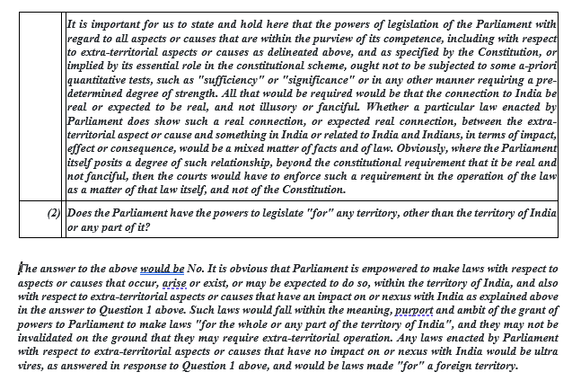
Taxation of Royalties and Fees for Technical Services including TDS under Section 195-I T ACT
Constitution of India Article – 245
CA Pradip K. Modi

Slide 8
Taxation of Royalties and Fees for Technical Services including TDS under Section 195-I T ACT
Chapter II (Section 4 -9B)
Section 5
CA Pradip K. Modi

Slide 9
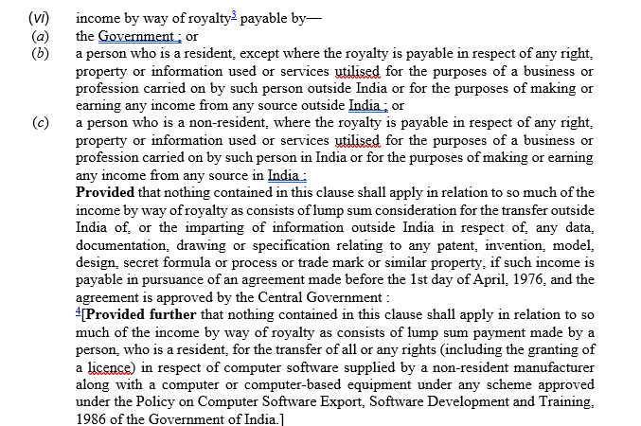
Taxation of Royalties and Fees for Technical Services including TDS under Section 195-I T ACT
Chapter II (Section 4 -9B)
Section 9
CA Pradip K. Modi

Slide 10
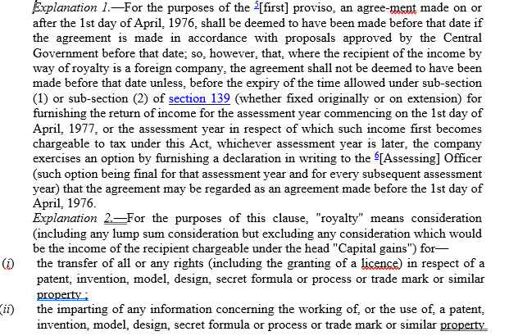
Taxation of Royalties and Fees for Technical Services including TDS under Section 195-I T ACT
Chapter II (Section 4 -9B)
Section 9
CA Pradip K. Modi

Slide 11
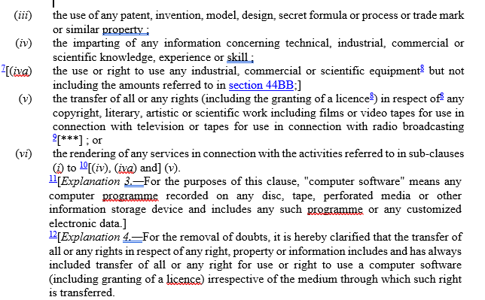
Taxation of Royalties and Fees for Technical Services including TDS under Section 195-I T ACT
Chapter II (Section 4 -9B)
Section 9
CA Pradip K. Modi

Slide 12
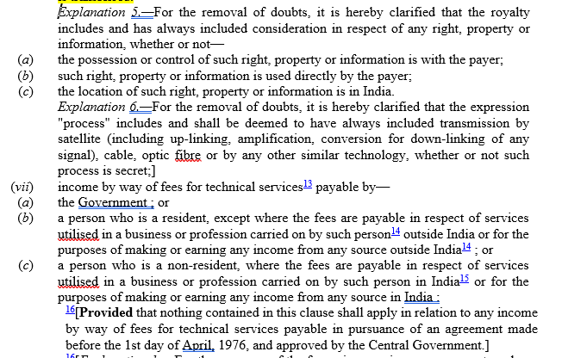
Taxation of Royalties and Fees for Technical Services including TDS under Section 195-I T ACT
Chapter II (Section 4 -9B)
Section 9
CA Pradip K. Modi

Slide 13
Taxation of Royalties and Fees for Technical Services including TDS under Section 195-I T ACT
Chapter II (Section 4 -9B)
Section 9
CA Pradip K. Modi

Slide 14
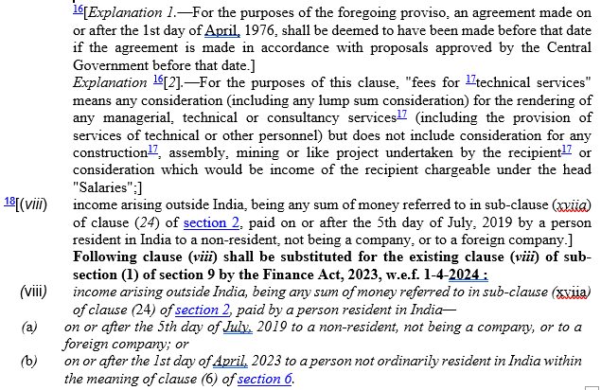
Taxation of Royalties and Fees for Technical Services including TDS under Section 195-I T ACT
Chapter II (Section 4 -9B)
Section 9
CA Pradip K. Modi

Slide 15
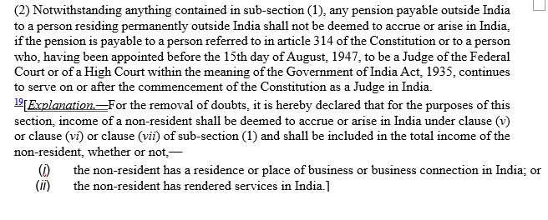
Taxation of Royalties and Fees for Technical Services including TDS under Section 195-I T ACT
Chapter II (Section 4 -9B)
Section 10
CA Pradip K. Modi

Slide 16
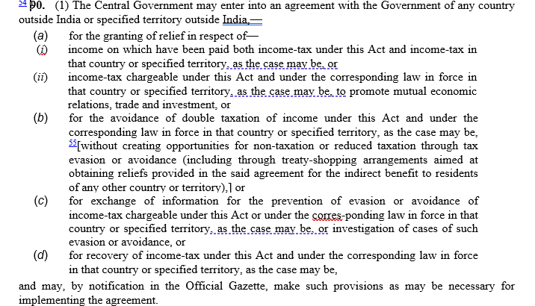
Taxation of Royalties and Fees for Technical Services including TDS under Section 195-I T ACT
Chapter IX (Section 90-91)
Insert Section 90
CA Pradip K. Modi

Slide 17
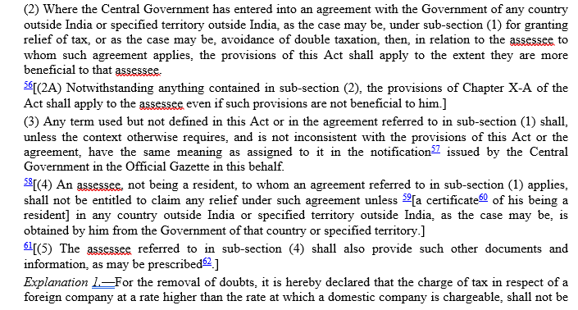
Taxation of Royalties and Fees for Technical Services including TDS under Section 195-I T ACT
Chapter IX (Section 90-91)
Insert Section 90
CA Pradip K. Modi

Slide 18
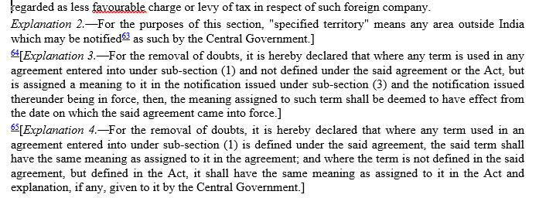
Taxation of Royalties and Fees for Technical Services including TDS under Section 195-I T ACT
Chapter IX (Section 90-91)
Insert Section 90
CA Pradip K. Modi

Slide 19
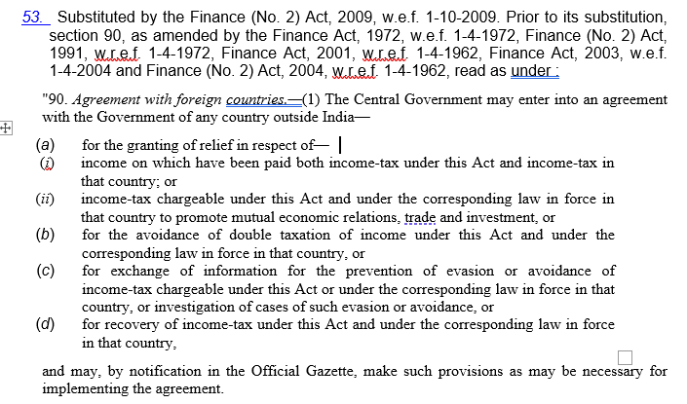
Taxation of Royalties and Fees for Technical Services including TDS under Section 195-I T ACT
Chapter IX (Section 90-91)
Insert Section 90
CA Pradip K. Modi

Slide 20
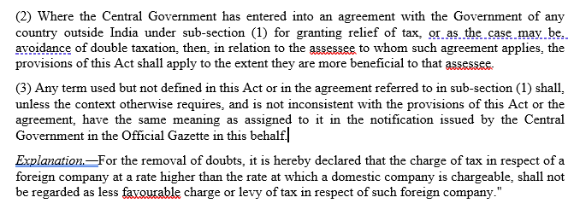
Taxation of Royalties and Fees for Technical Services including TDS under Section 195-I T ACT
Chapter IX (Section 90-91)
Insert Section 90
CA Pradip K. Modi

Slide 21
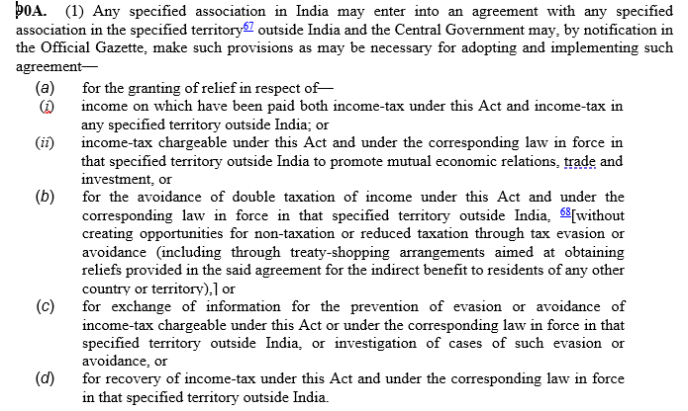
Taxation of Royalties and Fees for Technical Services including TDS under Section 195-I T ACT
Chapter IX (Section 90-91)
Insert Section 90 A
CA Pradip K. Modi

Slide 22
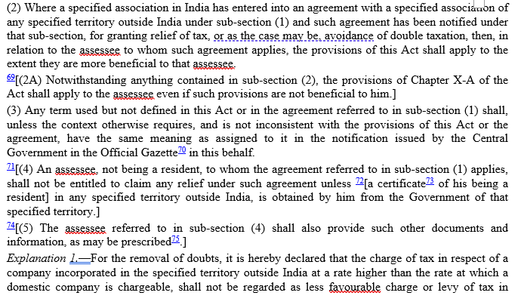
Taxation of Royalties and Fees for Technical Services including TDS under Section 195-I T ACT
Chapter IX (Section 90-91)
Insert Section 90 A
CA Pradip K. Modi

Slide 23
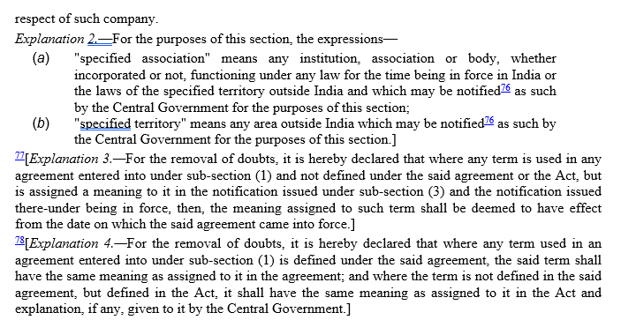
Taxation of Royalties and Fees for Technical Services including TDS under Section 195-I T ACT
Chapter IX (Section 90-91)
Insert Section 90 A
CA Pradip K. Modi

Slide 24
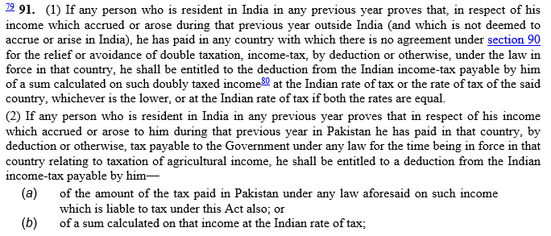
Taxation of Royalties and Fees for Technical Services including TDS under Section 195-I T ACT
Chapter IX (Section 90-91)
Insert Section 91
CA Pradip K. Modi

Slide 25
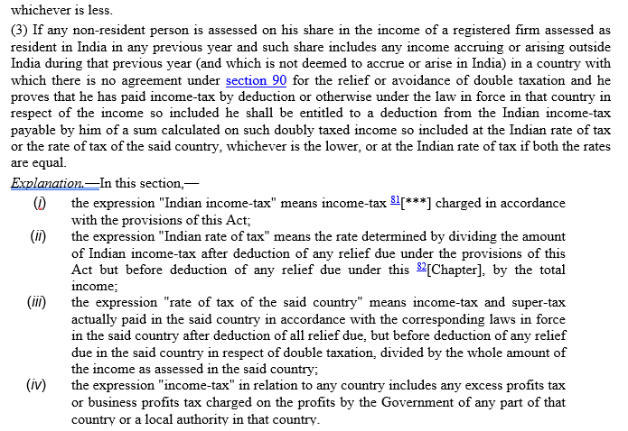
Taxation of Royalties and Fees for Technical Services including TDS under Section 195-I T ACT
Chapter IX (Section 90-91)
Insert Section 91
CA Pradip K. Modi

Slide 26
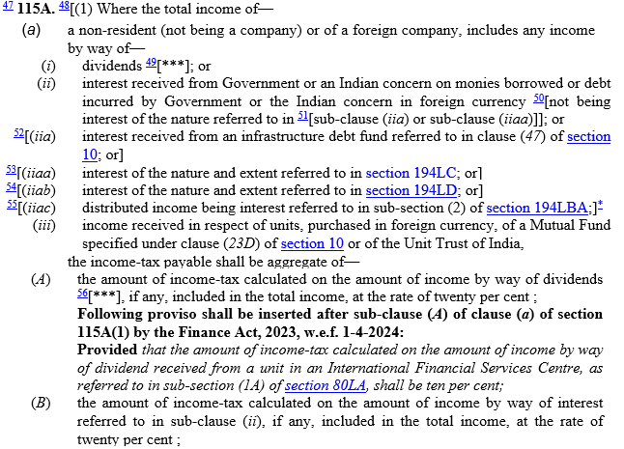
Taxation of Royalties and Fees for Technical Services including TDS under Section 195-I T ACT
Section 115 A
CA Pradip K. Modi

Slide 27
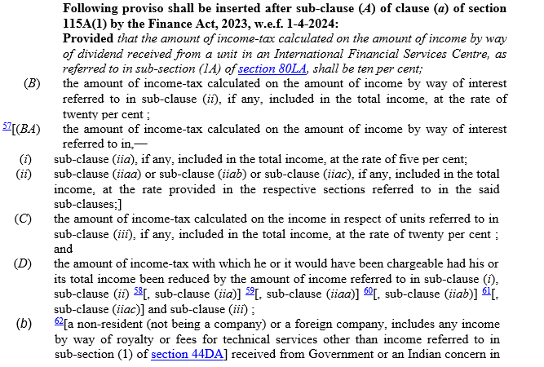
Taxation of Royalties and Fees for Technical Services including TDS under Section 195-I T ACT
Section 115 A
CA Pradip K. Modi

Slide 28
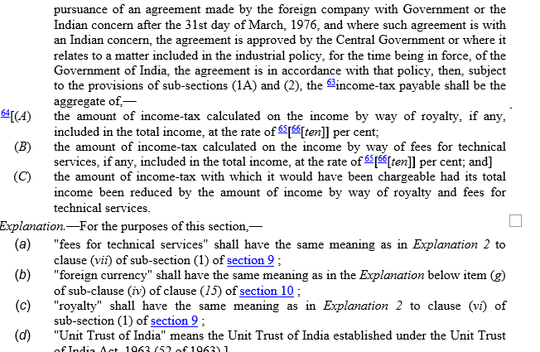
Taxation of Royalties and Fees for Technical Services including TDS under Section 195-I T ACT
Section 115 A
CA Pradip K. Modi

Slide 29
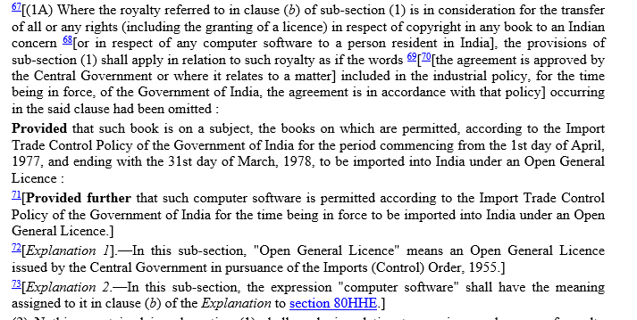
Taxation of Royalties and Fees for Technical Services including TDS under Section 195-I T ACT
Section 115 A
CA Pradip K. Modi

Slide 30
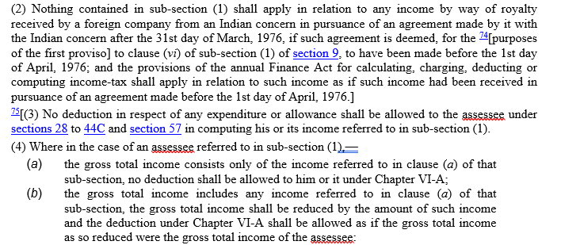
Taxation of Royalties and Fees for Technical Services including TDS under Section 195-I T ACT
Section 115 A
CA Pradip K. Modi

Slide 31
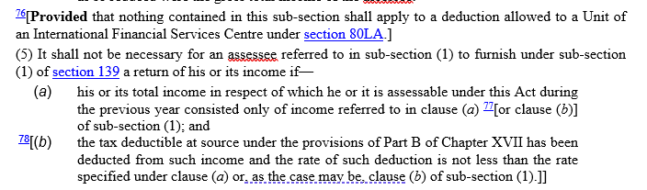
Taxation of Royalties and Fees for Technical Services including TDS under Section 195-I T ACT
Section 115 A
CA Pradip K. Modi

Slide 32
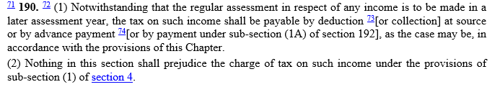
Taxation of Royalties and Fees for Technical Services including TDS under Section 195-I T ACT
Section 190
CA Pradip K. Modi

Slide 33
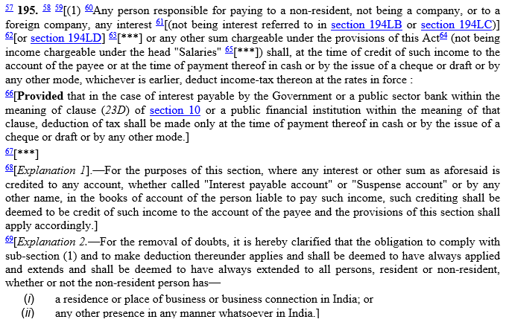
Taxation of Royalties and Fees for Technical Services including TDS under Section 195-I T ACT
Section 195
CA Pradip K. Modi

Slide 34
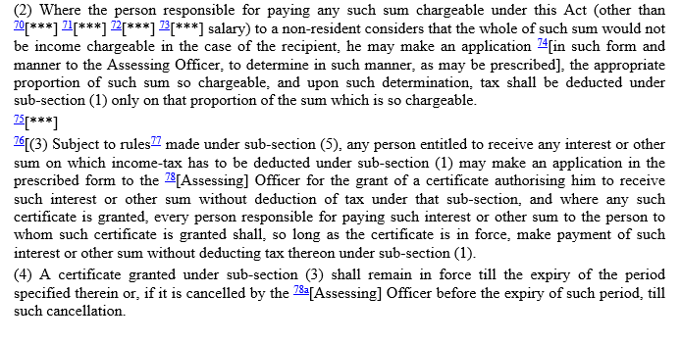
Taxation of Royalties and Fees for Technical Services including TDS under Section 195-I T ACT
Section 195
CA Pradip K. Modi

Slide 35
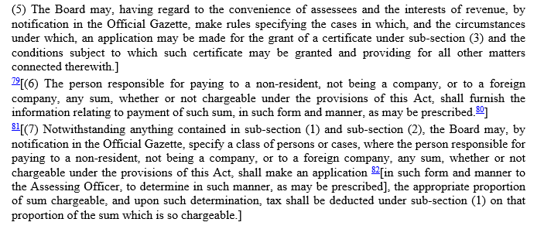
Taxation of Royalties and Fees for Technical Services including TDS under Section 195-I T ACT
Section 195
CA Pradip K. Modi

Slide 36
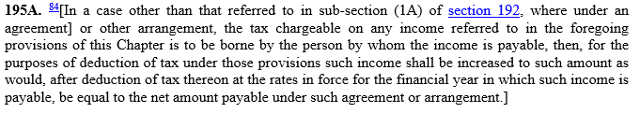
Taxation of Royalties and Fees for Technical Services including TDS under Section 195-I T ACT
Section 195 A
CA Pradip K. Modi

Slide 37
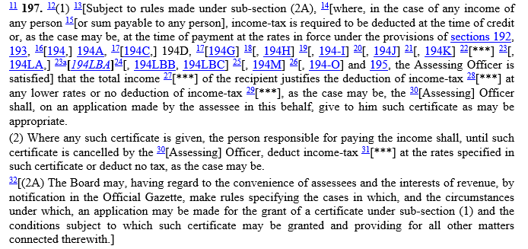
Taxation of Royalties and Fees for Technical Services including TDS under Section 195-I T ACT
Section 197
CA Pradip K. Modi

Slide 38
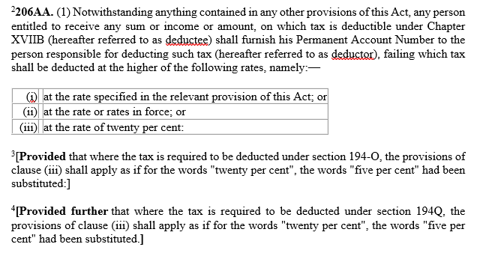
Taxation of Royalties and Fees for Technical Services including TDS under Section 195-I T ACT
Section 206 AA
CA Pradip K. Modi

Slide 39
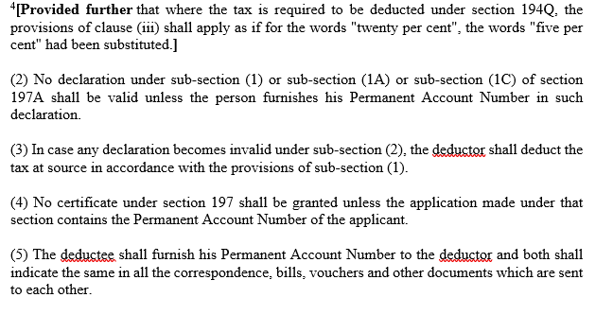
Taxation of Royalties and Fees for Technical Services including TDS under Section 195-I T ACT
Section 206 AA
CA Pradip K. Modi

Slide 40
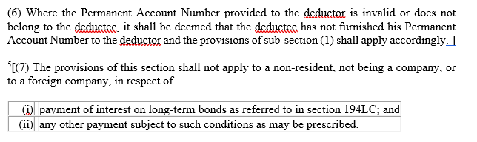
Taxation of Royalties and Fees for Technical Services including TDS under Section 195-I T ACT
Section 206 AA
CA Pradip K. Modi

Slide 41
Section Particulars
Taxation of Royalties and Fees for Technical Services including TDS under Section 195-I T ACT
Section Essence
Sec 195(1) Supportive section to charging section 4
Sec 195(2) Application for no deduction of tax at Source by Payer-No
form prescribed
Sec 195(3) Application for no deduction of tax at Source by Payee-
Form 15C may be used
Sec 195(4) Validity of Certificate issued by AO.
Sec 195(5) Power of CBDT to make rules w.r.t.Sec 195(3).
Sec 195(6) Furnishing information to Board relating to payments made
under sub section (1) form 10F r.w. penalty Sec 271 I
Sec 195(7) Power of CBDTto issue notification for making application
to AO w.r.t. any sum to be paid to NR.
Sec 195A Income Payable Net of Tax195-
CA Pradip K. Modi

Slide 42
MLI
1 Article 7 of MLI (Principal Purpose test)
No benefit of DTAA if one of the main purpose of transaction is to obtain DTAA benefit
2 Article 12 of MLI (Commissionaire arrangements)
Agent shall constitute PE if he plays a principal role in conclusion of contract Agent is not independent if his activities are wholly or almost wholly on behalf of enterprise or CRE
3 Article 13 of MLI (Specific Activity exemption)
Preparatory and auxiliary benefit for PE is not available if each activity is not P&A
Activities of CRE in State to be considered
Taxation of Royalties and Fees for Technical Services including TDS under Section 195-I T ACT
CA Pradip K. Modi

Slide 43
Taxation of Royalties and Fees for Technical Services including TDS under Section 195-I T ACT
Important Points
* Whether tax is deducted on whole sum of payment or sum chargeable to Income tax
GE India Technology Centre Pvt Ltd 7 Taxmann.Com 18(SC)
Whether payment by one Non Resident to another Non Resident within India or outside is attracting section 195.
B4U International Holding Ltd. 18 ITR 62 (Mum), GVK Ind 332 ITR 130 (SC)
CA Certificate not substitute to order u/s 195(2)
Mahindra and Mahindra Ltd 106 ITD 521 (Mum) – wrong certificate by CA – penalty - Rs. 10000
Under Section 271J------- No concealment proceeding allowed U/s 271C
Whether payment under void agreement gives rise of income and lead to application of section 195
Ericsson Communication Ltd 81 ITD 77 (Del)
Whether payment made in otherwise than in cash is also subject to tax deduction under section 195
Kanchanganga Sea Food Ltd – 352 ITR 540 (SC)
CA Pradip K. Modi

Slide 44
Taxation of Royalties and Fees for Technical Services including TDS under Section 195-I T ACT
Important Points
* If first few payments in aggregation below Rs.5 lakh –with later payments, exceeds Rs.5 lakh –whether
Form 15CB required only for payments after crossing Rs.5 lakh or also for earlier payments?
Only after crossing aggregate limit of Rs. 5 Lacs.
CA Pradip K. Modi

Slide 45
Whether surcharge & education cess to be added to DTAA rates
Sunil Vs Motiani 33 Taxmann.com 252 (Mum)
Whether in case of payment to be remitted for Royalty and FTS, relaxation from deduction of tax at higher rate under section 206AA, In case of non-residents not having PAN
Refer Rule 37 BC
Whether grossing up at s.206AA rate or at Rate in force Bosch Ltd 28 Taxmann.com 228
Read with Air India 153 Tm 181.
Whether DTAA prevails over s.206AA
Air India Ltd. 153 Taxmann.com 181 (SC).
Where rate of exchange on date of remittance differs from exchange rate on date of credit, whether TDS to be deducted on exchange rate difference?
Sandvik Asia Ltd. 49 507 554 (Pune)
Taxation of Royalties and Fees for Technical Services including TDS under Section 195-I T ACT
CA Pradip K. Modi

Slide 46
Whether nil certificate possible u/s 195(2)
Manglore Refinery & Petro chemicals 113 ITD 85
Time limit for passing order u/s 195(2)
Under Citizen Charter 2010, time limit 1 month
Appeal against order u/s 195(2) –s.248
Bangalore International Airport – 257 Taxmann 148 (kar)
Can order u/s 195(2) be revised by CIT u/s 263?
BCCI 97 TTJ 751 (Mum)
Can contrary stand to order u/s 195(2) be taken in assessment proceedings?
Elbee Services P Ltd 247 ITR 109
What is time limit to get approval u/s 197 of Income tax act for lower deduction of tax
Instruction – 1 dated 15.1.2014
Taxation of Royalties and Fees for Technical Services including TDS under Section 195-I T ACT
CA Pradip K. Modi

Slide 47
Section 195 –Refund of Excess TDS or u/s 10(6A) Income - 188 ITR 749
Circular 7 dt 23.10.2007, Circular No : 11 dt 26.4.2016, Tata Chemical 363 ITR 658
Universal cables 420 ITR 111 (SC)
Whether remuneration paid to Non Resident partner is subject to TDS u/s 195
Chunilal Mehta 6 ITR 521
Whether TDS to be made on payment basis to NR is possible
Inzi Control India Ltd – 101 Taxmann.com 112 Read with Rule 26
If treaty benefits are claimed, whether explanation to the section can override provisions
Lufthansa Cargo India 375 ITR 85 (Del)
Whether treaty benefit should be denied if TRC is not furnished?
Skaps Ind India P Ltd 94 Taxmann.com 448
How to determine residential status of Non Resident when payment is to be made in the beginning of the year
Previous year Residential Status.
Taxation of Royalties and Fees for Technical Services including TDS under Section 195-I T ACT
CA Pradip K. Modi

Slide 48
OVERVIEW OF SECTION 9
Taxation of Royalties and Fees for Technical Services including TDS under Section 195-I T ACT
Sr. No. | Particulars
1 | Business Profit Taxable if Business Connection in India or property or asset or source in India or transfer of a capital assets situated d in India {New retrospective Explanations 4 and 5 to section9(1) (i) for meaning of “through” and to cover indirect transfer
2 | Salaries Taxable if services are rendered in India [Section9(1)(ii)] (Refer EliLilly(SC))
3 | Dividends Taxable if paid by an Indian Company [Section9(1)(iv)]-(At present exempt)
4 | Capital Gains on Shares / Property Taxable if situs of Shares/Property in India
5 | Rental from Properties Taxable if situs of Property in India
6 | Interest/Royalty/FTS Taxable If sourced from India
CA Pradip K. Modi

Slide 49
dd
Taxation of Royalties and Fees for Technical Services including TDS under Section 195-I T ACT
Whether TDS U/s. 195 is applicable when payment is made for embedded software with hardware
Whether payment is made for software for which payer has no right to modify
Whether payment made by Reseller to Supplier be treated as Royalty
Whether payment for copyrighted article made available to user described as Royalty.
Whether payment for Non-exclusive and non transferable licence to use technology termed as Royalty
MOL Corporation (2024) 162 Taxmann.com 198 (SC)
Gracemac Corporation (2024) 161 Taxmann.com 510 (SC)
Miscrosoft Regional Sales Pte Ltd (2024) 159 Taxmann.com 279 (SC)
Engineering Analysis Centre of Excellence P Ltd. (2021) 125 Taxmann.com 42 (SC)
CA Pradip K. Modi

Slide 50
•
Managerial Service :
“Ordinarily the managerial services mean managing the affairs by laying down certain policies, standards and procedures and then evaluating the actual performance in the light of the procedures so laid down.”
Technical :
Technical service’ is not to be construed in the abstract and general sense but in the narrower sense as circumscribed by the expressions ‘managerial service’ and ‘consultancy service’, the expression ‘technical service’ would have reference to only technical service rendered by a human ,and Interconnect services regarded as not involving human intervention; services not regarded as technical
Taxation of Royalties and Fees for Technical Services including TDS under Section 19I T ACT
CA Pradip K. Modi

Slide 51
Consultancy
Dictionary meaning
The act of asking the advice or opinion of someone (such as lawyer)”
“…. seek from a presumably qualified personal or an advice, opinion, etc.”
What is difference between IPS (Independent Professional Services) and FTS (Fees for technical Services)
What is difference between FIS (Fees for included Service) and FTS
How to deal taxability for FTS in absence of FTS article in treaty
Taxation of Royalties and Fees for Technical Services including TDS under Section 195-I T ACT
CA Pradip K. Modi

Slide 52
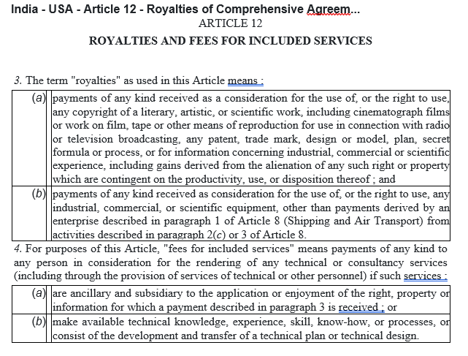
Taxation of Royalties and Fees for Technical Services including TDS under Section 195-I T ACT
CA Pradip K. Modi

Slide 53
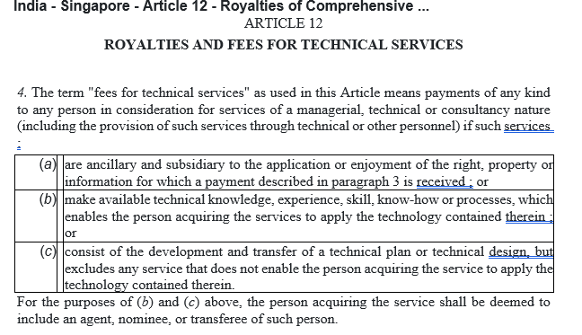
Taxation of Royalties and Fees for Technical Services including TDS under Section 195-I T ACT
CA Pradip K. Modi

Slide 54
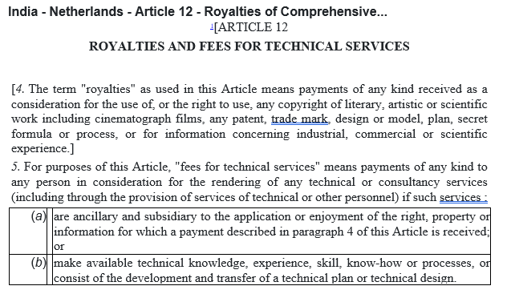
Taxation of Royalties and Fees for Technical Services including TDS under Section 195-I T ACT
CA Pradip K. Modi

Slide 55
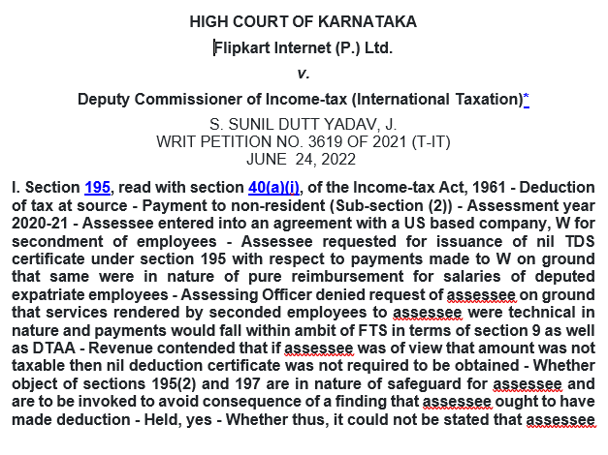
Taxation of Royalties and Fees for Technical Services including TDS under Section 195-I T ACT
CA Pradip K. Modi

Slide 56
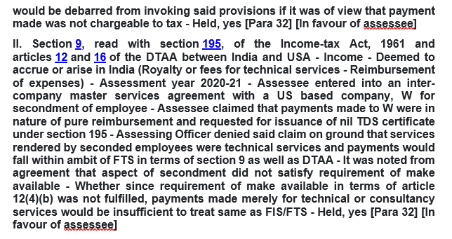
Taxation of Royalties and Fees for Technical Services including TDS under Section 195-I T ACT
CA Pradip K. Modi

Slide 57
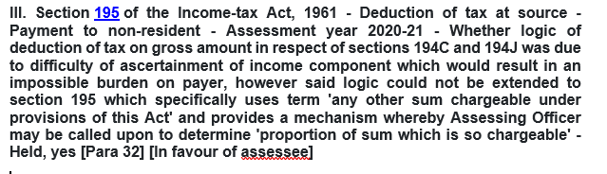
Taxation of Royalties and Fees for Technical Services including TDS under Section 195-I T ACT
CA Pradip K. Modi

Slide 58
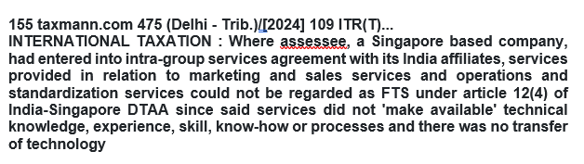
Taxation of Royalties and Fees for Technical Services including TDS under Section 195-I T ACT
CA Pradip K. Modi

Slide 59
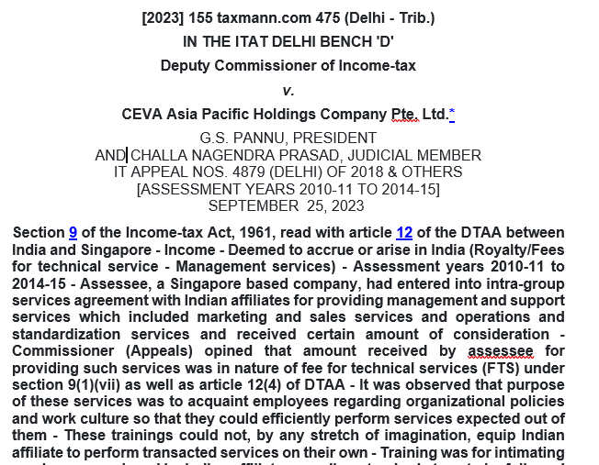
Taxation of Royalties and Fees for Technical Services including TDS under Section 195-I T ACT
CA Pradip K. Modi

Slide 60
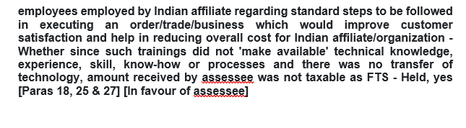
Taxation of Royalties and Fees for Technical Services including TDS under Section 195-I T ACT
CA Pradip K. Modi

Slide 61
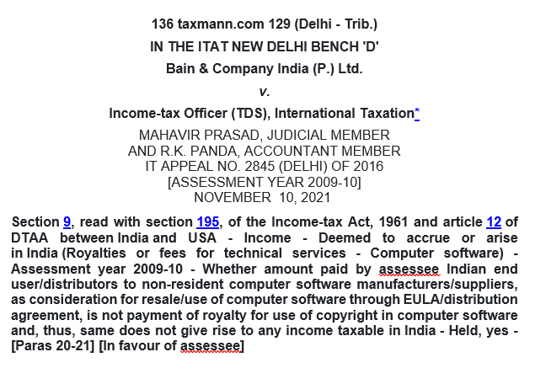
Taxation of Royalties and Fees for Technical Services including TDS under Section 195-I T ACT
CA Pradip K. Modi

Slide 62
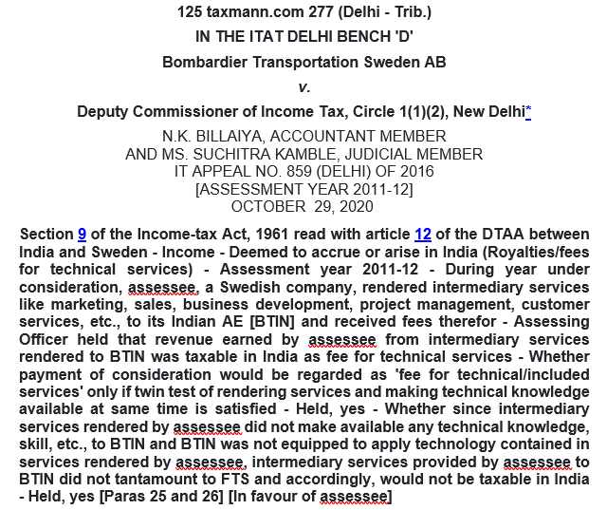
Taxation of Royalties and Fees for Technical Services including TDS under Section 195-I T ACT
CA Pradip K. Modi

Slide 63
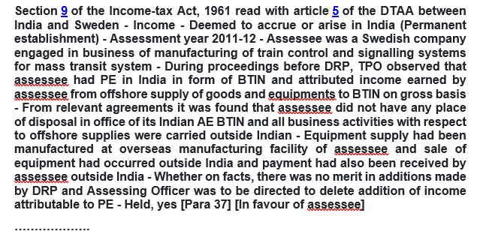
Taxation of Royalties and Fees for Technical Services including TDS under Section 195-I T ACT
CA Pradip K. Modi

Slide 64
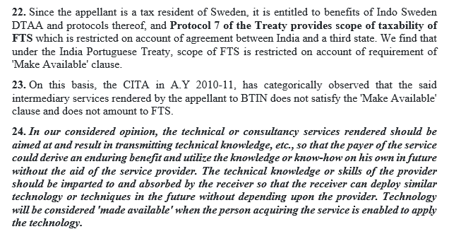
Taxation of Royalties and Fees for Technical Services including TDS under Section 195-I T ACT
CA Pradip K. Modi

Slide 65
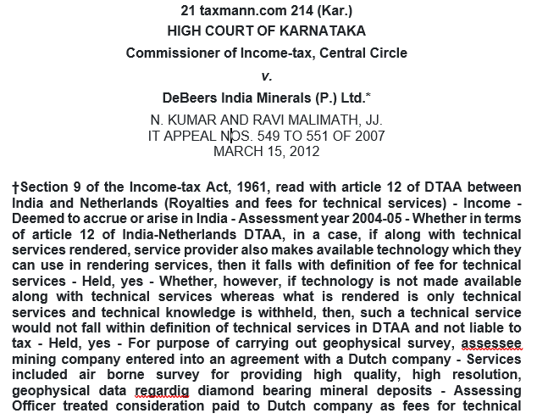
Taxation of Royalties and Fees for Technical Services including TDS under Section 195-I T ACT
CA Pradip K. Modi

Slide 66

Taxation of Royalties and Fees for Technical Services including TDS under Section 195-I T ACT
CA Pradip K. Modi

Slide 67
Thank you
CA Pradip Modi
+91 98240 14310 www.pkmodi.com

